Slide 1
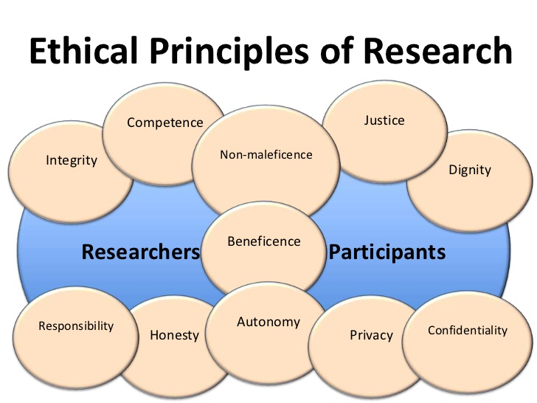
Ethics in research and studies
Richard Torkar

Slide 2

Me, myself and I
Professor at the division of software engineering
Senator at Chalmers’ Faculty Senate
Head of the SE division
Research interests mainly lay in software testing, Bayesian statistics, and human aspects in software engineering
Former officer in the Swedish Army
Have founded or co-funded six companies
Started at the computer science and engineering (CSE) department in 2013
Received my PhD in 2006

Slide 3
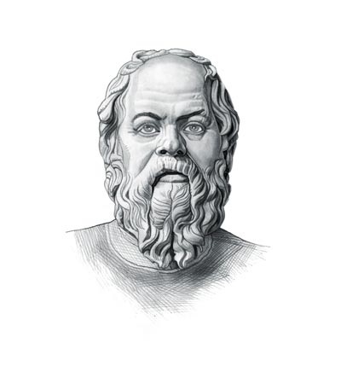
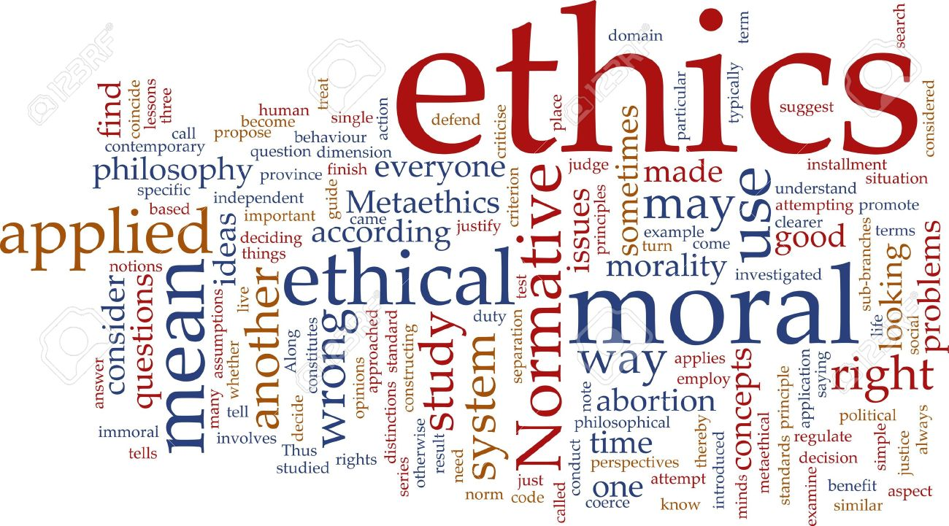
Definitions
Moral – practical and factual actions conducted by humans
Ethics – systematic reflection of human actions, and the reason for said actions

Slide 4
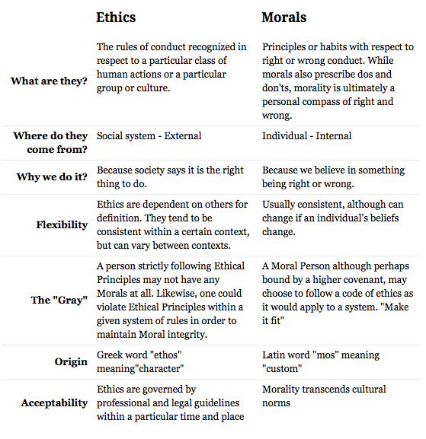
Definitions (cont.)
Notes:
Ethics is an external social system
Morals is an internal individual system

Slide 5

Rules of Conduct
What is permitted
What research should be done?
How should research/assignments be conducted?
How should research/assignments be reported?
Sometimes summarised in Codes of Ethics

Slide 6
What research should be done?
There is no such thing as perfectly ethical research
This is because you're using the most powerful tools science has to offer in getting at truth or some needed change, and with your results, somebody's going to be proven wrong or lose out in the power struggle.
There is no such thing as totally harmless research
Research is all about power and sometimes creating inequalities where a placid consensus may have existed before.
Somebody, usually your subjects, is going to be harmed, either psychologically, socially, physically, or economically.
Their privacy is, and should be, invaded to get any useful information (why do research on the obvious, surface characteristics of people?), and this is psychological harm.
Socially and physically, you're harming them by taking up their time with your silly research, and economically, you're exploiting them by not paying them for their contribution.
You, the researcher, will go on and become famous writing a book about them, but they will always remain lowly research subjects.

Slide 7
Ethical Models
The Value-Free Model -- the idea here is that rigorous research will yield results that can be used for anyone's benefit, for good or evil, for better or worse, and that in the long run, good will win out over evil if researchers adhere to methodological rigor and consistency
The Social Problems Model -- the idea here is that research is problem solving, all about understanding the world we live in a little better so that we can modify it toward some greater good
The Marxist Model -- the idea here is that there are three kinds of research: trivial; that which aids the bourgeoisie (or haves); and Marxist research which aids the proletariat (the have-nots).
The Vulnerable Populations Model -- the idea here is that research ought to be used to uplift or empower those social groups who lack power in society, especially by qualitative research which gives them a "voice"
The Government Pawn Model -- the idea here is that research ought to be of use to government decision makers so that better public policy can be made
The Corporate Shill Model -- the idea here is that research should be used to promote the interests of wealthy, powerful individuals or corporations with researchers for sale in "think tanks"
There's also probably a Self-Imposed Morality Model where the researcher simply refuses to cave in to any pressures or ideology, but I leave it to you in deciding if such a person gets much work.
Notes:
Rigorous

Slide 8
What research should be done?
Political Regulation
Some research is not allowed (e.g. public opinion surveys just before election, in some countries)
Some research is contracted to do national security work under the guise of academic research (e.g. CIA, NSA)
Economic Regulation
Who sponsors your research?
Which agenda does your sponsor have?
What is the impact of your sponsor?
Notes:
Sakerts polisen
Referal
Valeme Swedish industry research
Competitiveness

Slide 9
How should research be conducted?
Nuremberg Code
List of rules established by a military tribunal on Nazi war crimes during World War II.
Principles Include:
Voluntary consent
Avoidance of unnecessary suffering
Avoidance of accidental death or disability
Termination of research if harm is likely
Experiments should be conducted by highly qualified people
Results should be for the good of society and unattainable by any other means
The Nuremberg Code was later followed by
the 1948 U.N. Declaration of Human Rights
the 1964 Helsinki accord.
Notes:
Kunkunkunkunkunkunkun
Numerical trials
Consentration camp

Slide 10
Common recent guidelines
Subjects should be given a fair explanation of the purpose and procedures of the research
Subjects should be given a description of any reasonable risks or discomforts expected
Subjects should be told of any possible benefits to be obtained by participating
Researchers should disclose any alternative procedures that might be advantageous to the subject
Researchers should offer to answer any questions subjects may have during the research
Subjects should be told they are free to withdraw and discontinue participation at any time
Notes:
Not want to bias them beforehand
4th is often used in medicine
Saghlesga university of medicine
Ads Design
Remove learning bias TCCT test control
Exclude the data

Slide 11
Anonymity
Promise and keep your promises of anonymity.
After identifying your sampling frame, try to forget about taking names or any other unique identifiers.
Reassure people that you won't go to the media.
Fill them in on what journal outlet you have planned.
Promise to destroy your documents if they're worried about your response to being subpoenaed.

Slide 12
Common recent guidelines
Respect for persons -- the right to informed consent
Beneficence -- minimization of harm and maximization of benefits
Justice -- equitable distribution of benefits and burdens

Slide 13
Ethical Issues in Data Collection
Always use volunteers, do not pay your subjects.
Research is, after all, a gift of knowledge that your subjects freely give to you and you're supposed to freely give to the world.
There are three ways, and three ways only, to encourage participation ethically (Senese 1997):
Anonymity
Confidentiality
Informed Consent
Let’s see what happens when this collides with society, i.e., law…

Slide 14
Case study I: DAMP study (GU)
Gillberg and Rasmussen sent out a questionnaire to pre-school teachers (yes/no answers) with the purpose of identifying DAMP (deficits in attention, motor control and perception)
3400 children (72% RR), 340 judged as DAMP children (6-7 years old)
Follow-up at 10, 13, and 16 years of age
Final check at 22 years of age (published results then)
Kärfve and Elinder asked board of ethics to review the research
The specific accusation was that they had added participants to the control group for the final follow-up study at age 22 (low drop-out rate)
University said no evidence could be found of fraud
Kärfve and Elinder then asked for the data and were denied access (full confidentiality)
Court found later they had right to access data (offentlighetsprincipen, eng: principle of public access)
Court decided the exact conditions to gain access after appeal
May 6, 2004: data should be released… 22 shelf-meters (100 K pages, videos and sound)

Slide 15
Confidentiality
This is what you should promise if you can't keep anonymity.
In other words, use confidentiality if you can't guarantee anonymity.
You guarantee that:
no one will be individually identifiable in any way by you,
that all your tables, reports, and publications will only discuss findings in the aggregate.
This is one of the basic rules of research

Slide 16
Informed Consent
Be honest and fair with your subjects.
Tell them everything they want to know about your research.
Be aware of any hidden power differentials that might be pressuring them to participate.
For example, if you're a teacher or authority figure of any kind, and your subjects consist of your students or people in a status reporting to you in some other way, then reflect upon the possibility that they're participating for the possibility of unintended side benefits.

Slide 17
Ethical Issues in Data Collection
Get permission from individuals and individuals in authority
e.g. line managers
Respect research sites – minimise disruption
Do not ruin a company because of a badly thought through research study
All should benefit
What do you teach the control group?
Be open
Do not coerce people to join the study
Confidentiality!
What the participants tell you stays with you. No matter what.

Slide 18
Consent Form
Bare Minimum:
“I have been informed and understand the personal and professional risks involved by participating in this study. I agree to assume those risks, and my participation is purely voluntary, without any promise of special rewards as a result of my participation.”
More Detailed (adapted from Neuman & Wiegand 2000):
A brief description of the purpose and procedure of the research, including the expected duration
A statement of any risks, discomforts, or inconveniences associated with participation
A guarantee of anonymity or at least confidentiality, and an explanation of both
The identification, affiliation, and sponsorship of the research as well as contact information
A statement that participation is completely voluntary and can be terminated at any time without penalty
A statement of any alternative procedures that may be used
A statement of any benefits to the class of subjects involved
An offer to provide a free copy of a summary of the findings
There is no black and white here – a grayscale exists…

Slide 19
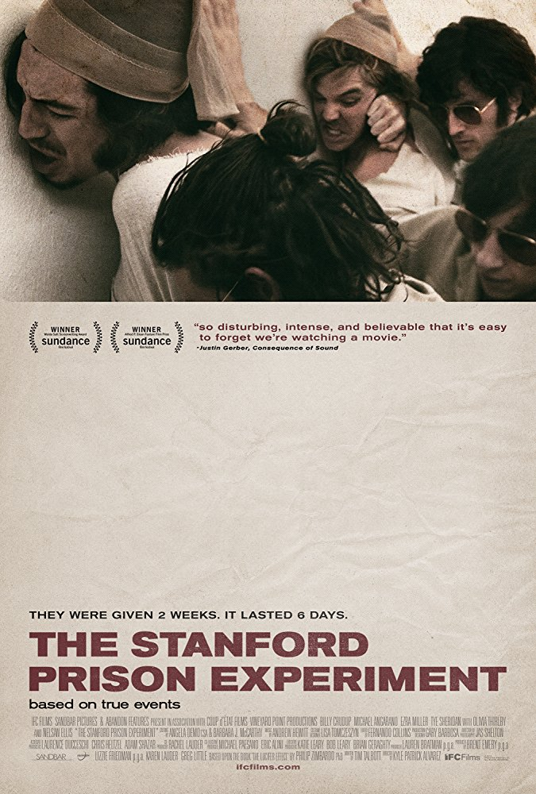
Lots of “failed” experiments… Case study II

Slide 20
Case study III: The monster experiment
Wendell Johnson from the University of Iowa conducted a stuttering experiment on 22 orphan children in 1939.
The children were put in four control and experimental groups.
Half of the kids were given praises and compliments on their fluency of speech, and negative feedbacks to the other half by belittling them for even tiny speech imperfections.
Children in experimental groups were also constantly told that they were stutterers.
The result?

Slide 21
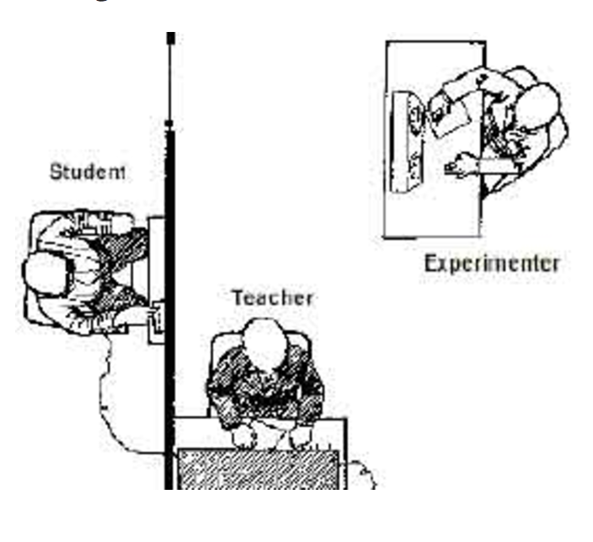
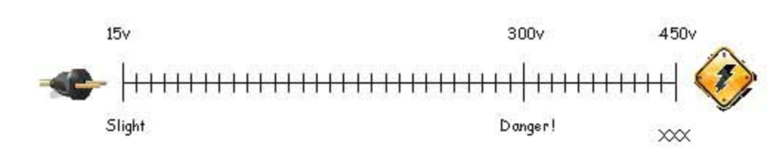
Case study IV: The Milgram experiment
Stanley Milgram – psychologist at Yale University.
Conducted an experiment focusing on the conflict between obedience to authority and personal conscience (1961).
He examined justifications for acts of genocide offered by those accused at the World War II, Nuremberg War Criminal trials. Their defence was often based on “obedience”, i.e., that they were just following orders from their superiors.

Slide 22

Case study IV: The Milgram experiment

Slide 23

What’s in it for you…
What we’ve seen so far are extreme cases, but what does it mean for you?

Slide 24
Fraud
Omission
Do not say something that should be said
Commission
Say something false

Slide 25
Fraud
Fabrication
making up data, lying about procedures
Keep field records and logs
They are your proof of what you actually did
Falsification
manipulating data to obtain a desired outcome
e.g. discarding data
Be open and discuss in the article what you discard and why
Plagiarism (self-)
taking credit for someone else’s work

Slide 26
Software Engineering Code of Ethics
http://www.computer.org/tab/seprof/code.htm
Software engineers shall commit themselves to making the analysis, specification, design, development, testing and maintenance of software a beneficial and respected profession. In accordance with their commitment to the health, safety and welfare of the public, software engineers shall adhere to the following Eight Principles:
PUBLIC - Software engineers shall act consistently with the public interest.
CLIENT AND EMPLOYER - Software engineers shall act in a manner that is in the best interests of their client and employer, consistent with the public interest.
PRODUCT - Software engineers shall ensure that their products and related modifications meet the highest professional standards possible.
JUDGMENT - Software engineers shall maintain integrity and independence in their professional judgment.
MANAGEMENT - Software engineering managers and leaders shall subscribe to and promote an ethical approach to the management of software development and maintenance.
PROFESSION - Software engineers shall advance the integrity and reputation of the profession consistent with the public interest.
COLLEAGUES - Software engineers shall be fair to and supportive of their colleagues.
SELF - Software engineers shall participate in lifelong learning regarding the practice of their profession and shall promote an ethical approach to the practice of the profession.

Slide 27
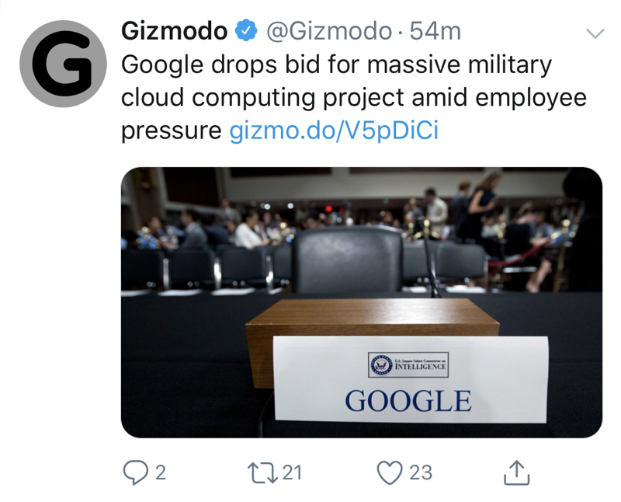

Slide 28
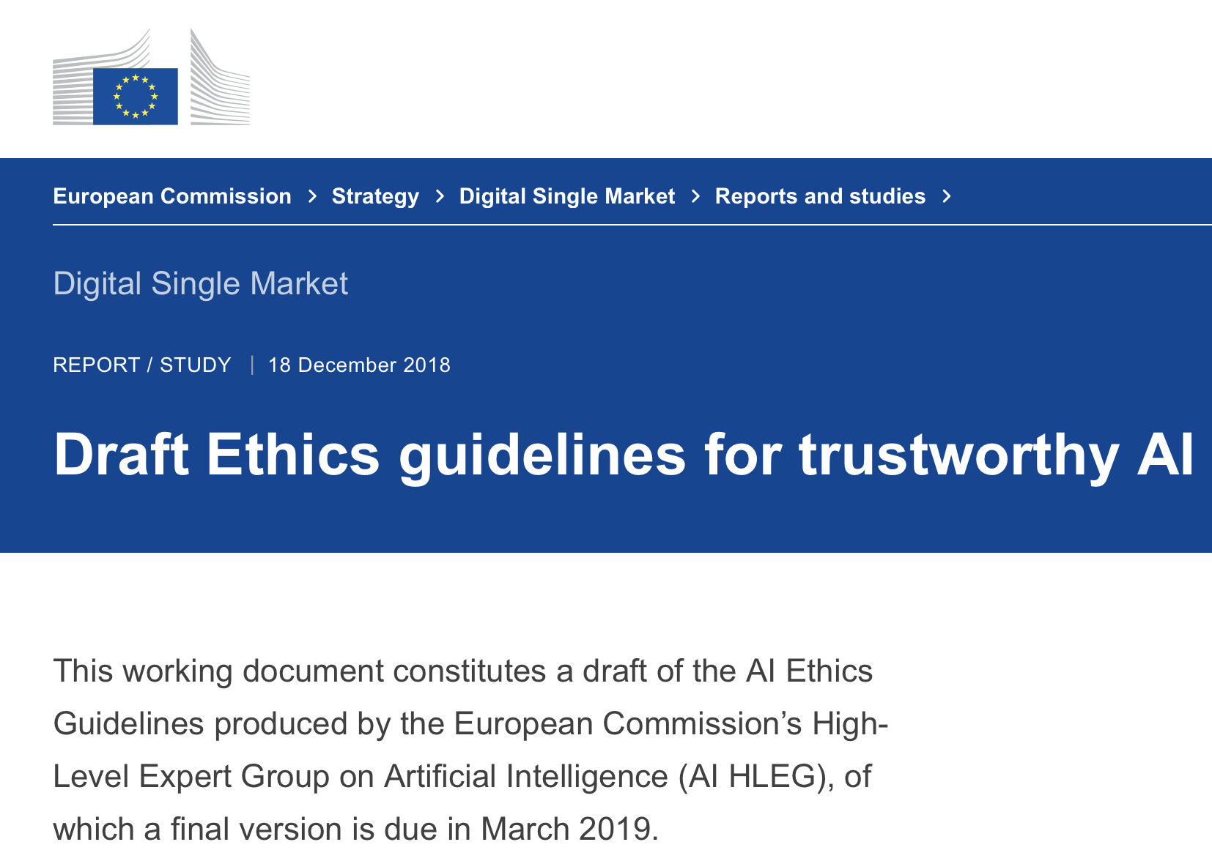

Slide 29
Homework
Each group must make an ethics assignment to be sent in to the examiner (Erland Jonsson) before Sun 2017-10-08, 23.59.
The assignment is to write an essay that discusses a specific ethical issue/question. The essay should typically be 1-2 pages.
Please note that there are no ”right answers” to these questions. Your essay will be judged from your discussion of the topic (pass/fail).
Please note that only one essay per group (not per student) is to be sent to the examiner.

Slide 30
Homework
The question-to-group allocation is:
Question 1: Groups 1, 6, 11, 16, 21
Question 2: Groups 2, 7, 12, 17, 22
Question 3: Groups 3, 8, 13, 18, 23
Question 4: Groups 4, 9, 14, 19,
Question 5: Groups 5, 10, 15, 20,
The five questions are presented on the following slides.

Slide 31
Question 1
You have led a study where you have investigated the effectiveness and efficiency among programmers at several large companies. After you have concluded your study, one of the participating companies asks for the collected data. The company wants to use the data as input for assessing individual engineers’ performance at the company. You promised all participants confidentiality. Are you legally and/or ethically obliged to provide the data if no agreement has been signed with the company regarding these issues? Argue your case!

Slide 32
Question 2
In fraud they make a distinction between omission/commission and fabrication, falsification and plagiarism. Can you exemplify, and provide a strategy to counter this threat?

Slide 33
Question 3
Considering the common ethical models (pp. 6), in your opinion, which model should guide a modern society? Why?

Slide 34
Question 4
On June 9, 2011, Google released a “doodle” honoring Les Paul which the users then found addictive to play with. A third party, RescueTime, estimated that 5.3 million hours were spent playing this game, i.e., about eight lifetimes…
http://elgoog.im/guitar/
Did the doodle make a positive contribution to the world?
Do engineers at Google have an obligation to consider this question before releasing the feature?
What principle(s) should they use to determine the answer?
Notes:
Example from https://www.scu.edu/media/ethics-center/technology-ethics/Students.pdf

Slide 35
Question 5
You work for a large telecom operator. You overhear your managers speak about a contract the company has gotten from a country. The country is a dictatorship. You realize that the functionality your work on has been requested by that country and can be used to search for keyword strings in emails, Skype, phone conversations etc. What do you do?
Who are the stakeholders, and what do they each have at stake depending on what you do?
What is your ethical obligation?
Notes:
https://www.scu.edu/media/ethics-center/technology-ethics/Students.pdf

